Slide 1
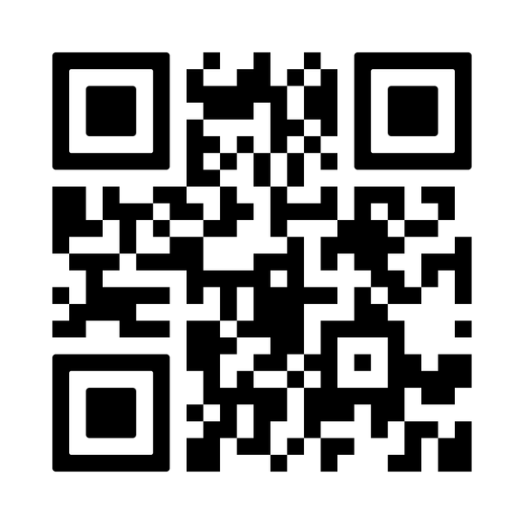



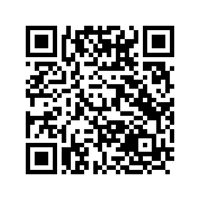


Headstart Kernow - FREE Wellbeing Support for Schools
We offer a universal preventative approach to support the wellbeing of the whole school community:
  Information & expertise
  Resources
  Tools
  Training - online, on demand, face to face & bespoke
  Signposting
  Information / resources for children & YP
  Information / resources for parents & carers
Find out more on our website www.headstartkernow.org.uk
Download posters / flyers for staff / colleagues
Our support is available to, and suitable for all staff and governors
A whole school, relational approach that is ‘Everybody’s Business’
SPACE for parents and carers Brilliant ME! wellbeing resource Resilience Framework. Digital Resilience. Grandma on the Moon WSA appproach. START NOW

