Slide 1


Understanding and responding to self-harm in schools
Dr Lynette Rentoul, Independent Consultant Clinical Psychologist
Clinical Lead, CAMHS, NHS Kernow Clinical Commissioning Group

Slide 2
What does self-harm include?
Self-harm includes a wide range of behaviours and differences in intensity, severity, complexity and frequency of self-harming behaviours –including:
Self cutting.
Self hitting; self punching.
Burning or scalding self.
Pulling hair.
Picking or scratching one’s skin.
Self-asphyxiation.
Ingesting toxic substances (wide range).
Overdose of medication.
Fracturing bones.
Hitting, kicking walls or hard objects
Self-harm may be linked to depression or anxiety or it may start with no previous history of mental health problems

Slide 3
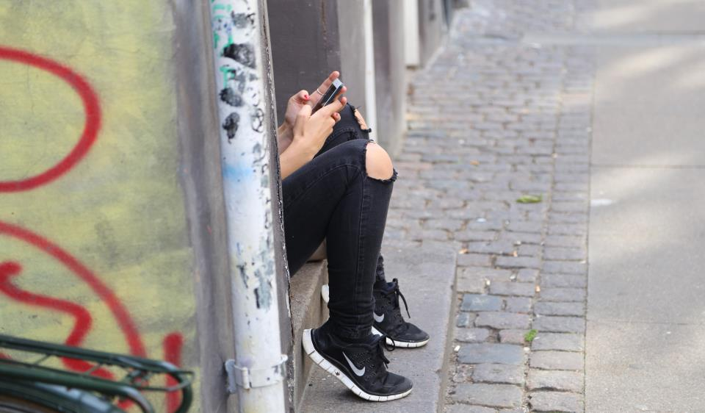
How do younger children harm themselves (among Primary school age children?)
Biting, hitting or punching self.
Banging one’s head on school desk.
Harming self by jumping off climbing frame, -placing themselves in danger; highly prone to having accidents; or harm in fighting.
Attack themselves rather than expressing their anger or distress directly.
Scratching or cutting themselves (e.g. with blade from pencil sharpener).
Pulling out hair
Self asphyxiation
Notes:
From 5 years old children under stress may harm themselves –including serious attempts at significant harm, even suicide (such as attempted hanging)

Slide 4
Who self-harms?
Children from all walks of life harm themselves, regardless of their ethnic, religious, cultural, class background (peaks in wealthy and deprived areas). Both boys and girls harm themselves (some differences). | Children more likely to harm themselves between ages 13-18 years (but children as young as four can harm themselves, including severe self-harm).
Increased risk: suicide or self-harm in family member; low self-esteem; relationship difficulties; family conflict; abuse, neglect, and trauma; isolation; bullying (cyber bullying; homophobic; transgender); mental health problems; domestic violence; periods in care of LA. | 50% of children identified for support in the Mind and Body (MAB) self-harm programme were not known to any agency.
Notes:
In Cornwall children from wealthy areas and deprived areas are included in high risk areas for self-harm; increased self harm among children facing bullying based upon their sexual orientation or identity. Very interesting to note that 50% children who self identified as in need of support for their self-harming had spoken about this for the first time and were known to no agencies.

Slide 5
Understanding self-harm
Self-harm may be a response to strong feelings and distressing experiences, which are hard to deal with. During adolescence, young people may encounter particularly painful emotional events for the first time. Adolescents who self-harm describe feelings of powerlessness and despair, and say they turn to self-harm to release powerful and frightening emotions, relieve unbearable tension, or gain a fleeting sense of control.
‘Do More Good Than Harm’ 2006

Slide 6

In the words of a child…
Self-harm used to be a way
of getting rid of the feelings
inside me. To get rid of all the hurt, anger and pain that I was feeling. The rush it gave, the sense of feeling better was always short-lived. So short that I was doing it many times… I’m trying to get my life ‘normal’, though for me self-harm is normal. Something that I have always done to mask my feelings in any other way and find talking exceptionally difficult.
Notes:
This quote includes many of the key themes of Self-Harm

Slide 7

Why children self-harm
Dealing with intense and painful feelings of distress, rage, frustration, which build up. Self harm provides immediate relief from tension (for those struggling with emotion regulation).
Communicating distress, especially for young people who find it difficult to talk about their feelings.
Gives child sense has some control in their life, (when they feel they have v limited control in life; feel trapped and helpless).
Way to influence others e.g. to elicit care, affection or confirm love from those close to them.
Self punishment (in context of low self-esteem).
Way to distract from intense emotional pain.
May help some YP feel more alive and connected (especially those feeling deadened and numb by history of harm and abuse).
Some young people don’t know why they harm themselves or understand their triggers.
Among children who cannot call upon more healthy ways of coping (limited self regulation skills), becomes habit they cannot break. Some are influenced by powerful peer group.
Notes:
It is important to have a discussion here about how the skills to regulate emotions develop during childhood; and what problems arise when they are either poorly developed or when the skills are overwhelmed by powerful and unmanageable feelings.

Slide 8
Some triggers for Self-Harm
Stress
Family conflict, arguments and violence
Friendship and relationship difficulties
Loneliness/ isolation
Low self esteem
Confusion about gender and/or sexual identity
Bullying
Distressing or frightening thoughts or memories
Feeling very low or anxious
Unable or difficulty in talking to friends or trusted adult –feeling very alone, frustrated or misunderstood

Slide 9
Short videos made by young people
Mind and body programme Self-harm awareness day
Mind and Body Programme
Step Out of the Crowd
1
Mind and body programme
Remote but not alone
Notes:
This is a film made by the Mind and Body Programme in Kent

Slide 10
Self-harm increasing across the country
Number of girls under the age of 18 years treated in hospital after self-harming has nearly doubled compared with 20 years ago. | The figures for boys are increasing but at a lower rate. It may be harder to recognize self-harm in boys, because it may look superficially like aggression (such as punching wall), where boy is harmed.
13,463 last year compared with 7,327 in 1997
The number of girls treated for substance overdose has risen tenfold over 20 years. | Self harm reported to GPs increased 68% over last three years.
Self-harm among children three times more common in girls than boys. | Those self-harming are at greater risk of suicide.
Notes:
We are not clear why there is such a huge increase, but it is occurring across the country. Cornwall slightly above average and UK is higher than many other European countries.

Slide 11

What is driving self-harm among young people?
History of adversity, harm and trauma increases self-harm
Internal factors include how well child copes with stress and strong feelings - poor capacity to regulate feelings and cope with challenge and stress.
Brain development during phases of adolescence (the amygdala increases in size at different rate than the pre-frontal cortex) makes it much harder to regulate strong feelings during height of puberty.
Lack of safe, supportive and understanding family environment
Increased family pressures (past and ongoing) –conflict and DV.
School based pressures - including cyber bullying.
Relationship pressures - including social media.
Identity problems - including gender identity.
Contagion among strong peer groups.
Impact of lockdown on families and young people
Notes:
Many report increasing role of cyber bullying and greater pressures at school. Relationship difficulties are also seen at the heart of problems –especially isolation and loneliness. Family pressures are cited by many children.

Slide 12
Spotting warning signs of self-harm
Changes in eating and sleeping habits. | Wearing heavy clothes even in warm weather.
Expressing feelings of failure, uselessness, loss of hope. | Poorer level of school attendance.
Increased isolation from family and friends. | Lowering of school or college grades.
Talking about self-harm or suicide. | Undue interest in toxic substances.
Drug or alcohol misuse | Risk taking behaviour.
Appear more distressed. | Appears more withdrawn or irritable
Notes:
Many young people who harm themselves are not known to any agency or to the school (50% in the MAB programme). They have not spoken about it to anyone. Spotting young people in distress may be helpful in opening up helpful conversations.

Slide 13
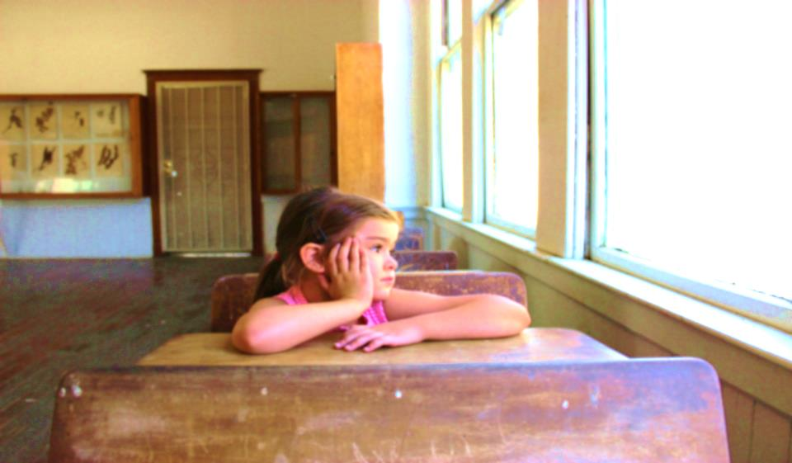
Self-harm and suicide
Majority of children who harm themselves are not trying to kill themselves - just coping with feelings.
It is not always clear from the severity of the self-harm what the intention of the child is.
Self-harming offers opportunity to help children cope with strong feelings and external stressors.
It is also a vital opportunity to explore intentions.
Sometimes the self-harm can become increasingly dangerous (by intent or accident) and can become real threat to life - requires monitoring (see Healthy Cornwall training programme).
Serious self-harm increases risk of suicide
Notes:
Self harm is an increased risk for suicide in childhood; but most self-harm is unlikely to lead to suicide attempts. Conversation prompts are included in the guidance, including questions about intent -these are tabled.
Recommend www.healthycornwall.org.uk/training-programme

Slide 14
What is helpful when responding to self-harm: be a compassionate and trusted adult
Empathic, patient, non-judgemental - listen and care. Reassuring and supportive. | Accept that self-harm helps them cope.
See the person behind the self-harm - focus on feelings, rather than self-harm - co-regulation. | Accept mixed feelings -the young person might hate their self-harm, even though they might need it.
Show concern for the child’s injuries, - compassion shows their body is worth caring about. | Voice concerns you have, listen to the child’s views on what they want to happen. ‘Available adult’.
Recognise how hard it is for child to talk to you – it is a big step, it takes courage to discuss self-harm. When they talk they are not alone. | Help young person to identify the triggers. Help child find alternatives to self-harm.
Notes:
What is being described here is “an emotionally available adult” (which is at the heart of the TIS training). An emotionally available adult can provide a vital sense of safety and support. Most children who self-harm report how helpful it is to talk about it to compassionate person. This provides a sense of Safety and connectedness with a supportive person.

Slide 15
What is not helpful when responding to self harm?
Don’t tell the person off or punish or blame them. Don’t be judgemental. | Don’t make assumptions about why the young person is self-harming -each young person is individual.
Don’t avoid talking about it, avoiding talking won’t stop self-harm, but will leave child feeling alone. Don’t be dismissive. | Don’t try to force them to stop self-harming - they need to want to stop and find help and skills to do this.
Don’t ask a young person to promise not to self-harm. Don’t promise to keep this secret. | Don’t treat the young person as mad or incapable. This takes away their self-respect and ignores strengths.
Panicking and overreacting can be very frightening for children - stay calm and talk and help them cope.
Notes:
Anything that makes a child feel judged, criticized, shamed, embarrassed, or unsafe is likely to be unhelpful. It is important to recognize that children are harming themselves because it is experienced a fleetingly helpful. It will take time to manage strong emotions in more healthy ways, and will need time and support.

Slide 16
Young peoples views on helpful school approaches
Whole school consistent approach to mental health. | Whole school needs to know who first aiders are and make students aware of this. | Discuss mental heath in PSHE, create ethos of understanding and acceptance - non-stigmatising.
All school staff aware of what support is available in school - supports consistency. | Important for students with mental health problems to have updated, shareable records. | ‘Safety plans’ student led and held by school (may use the MH and Wellbeing Road Map developed by YP Cornwall).
A safe comfortable environment within the school to go to if distressed.
Notes:
In developing the Guidance and training in self-Harm for School the Commissioning team worked closely with Young People Cornwall.

Slide 17
Young peoples views on unhelpful school approaches
Lack of privacy within the school environment for students who self harm. | Stigmatising and inappropriate language (such as “attention seeking”; or mocking). | Passed off to other services without explanation or compassion (‘fobbed off’). | A lack of consistency in approach to self-harm.
A stigmatising environment with a lack of mental health awareness.

Slide 18
Young people’s 10 top tips for schools
Comfortable environment with privacy and safety when dealing with self-harm. | Teachers’ awareness of student’s needs where appropriate. | Aware and open approach/ culture to mental health and self-harm across the whole school community. | A plan for all students with mental health difficulties including self-harm. | Involve parents where possible and with permission (always notify students before contact is made).
Good and consistent communication about self- harm –with clear set of procedures. | Regular input about mental health in PSHE; embed mental health issues in all subjects. | Take self-harm seriously (but also with appropriate humour and humanity)! | Have a clear plan of action for young people struggling and in crisis (student led). | Have regular check-ins with students known to be struggling (even when they appear OK).
Notes:
These 10 tips are derived from work with Young People Cornwall. It is worth discussing Safety Plans and the Mental Health Map developed by young people.

Slide 19
Cornwall I-Thrive framework for self- harm: Pathways of support and treatment
Coping and advice
Support and guidance in schools; TIS
Getting help
Getting help from primary mental health; BLOOM; MAB; voluntary sector; YPC young people Cornwall
Getting more help
Getting more help; specialist CAMHS/CAP
Risk support
Managing risk; social care and CAMHS; safety plans
Ed. Psych
PH written guidance
Bloom networks
Youth support
Wellbeing practitioners
Notes:
Pathways for Self Harm include support and Guidance in Schools( and in the community); Getting Help is via the Early help Hub and the Bloom Project (which is rolling out across the county during 2019). The help at this level is evidence based, focused interventions by expert services from primary mental health, the Voluntary Sector, and Social Care; Educational Psychology; Getting More Help is via the Early help Hub and led by Specialist CAMHS, and draws upon teams within Specialist CAMH services (including in-patient services to be opened in the Spring 2019); when young people present with ongoing high levels of risk and do not engage with mental health services, the risk is held by teams in Social Care and CAMHS

Slide 20

Support for children who self-harm: links with other agencies
I-Thrive Framework supports mental health pathways across all levels of care and treatment -from early intervention in schools and community to highly Specialist CAMHS
Written Guidance provided by Public Health and local CCG
Trauma Informed Schools (TIS), and Young People Cornwall (HOV) provide support in schools and community
Youth support services and Wellbeing practitioners
Mind and Body programme (MAB) gives support in schools for pupils who self-harm.
Bloom networks across the county provide advice and guidance for schools, primary health and social care.
TIS provides support in schools.
MHST provide help and support in Primary Schools
Social Care provide support –in relation to Safeguarding & risk
Notes:
It will be important to check how well participants understand the I-thrive approach and how it will be rolled out across Cornwall. This can be explored in groups.

